Slide 1
Lecture 2:
Global Environmentalism
Course: Environment and Politics in India

Slide 2
Thinking through the ‘environment’
“Nature! We are encircled and enclasped by her – powerless to depart from her, and powerless to find our way more deeply into her being. Without invitation and without warning she involves us in the orbit of her dance, and drives us onward until we are exhausted and fall from her arm…we live in the midst of her and yet to HER we are alien. She parleys incessantly with us, and to us she does not disclose her secret. We influence her perpetually, and yet we have no power over her”
Goethe, “Ode to Nature”

Slide 3
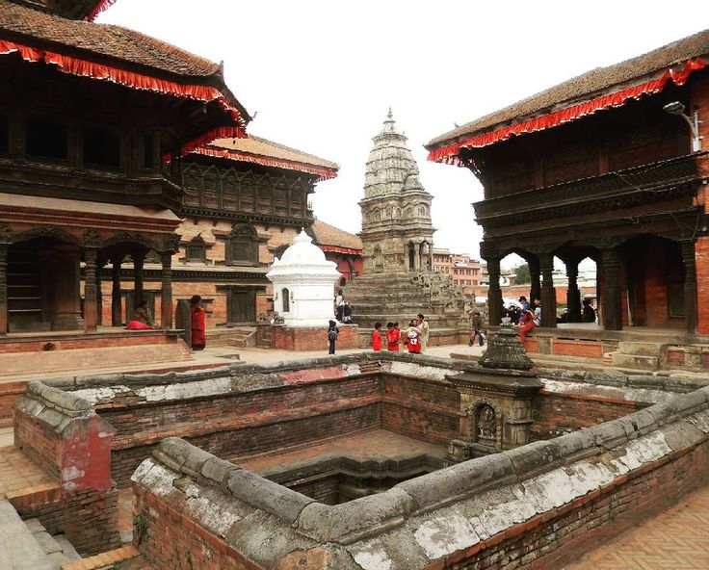
Man and Nature relationships
Shifting historical conceptions:
Nature as an ADVERSARY to be feared – bringing plague, floods, catastrophe, famines.
Nature as DIVINE power/God punishing humans for ‘misdeeds’. Needs to be worshipped/placated.

Slide 4
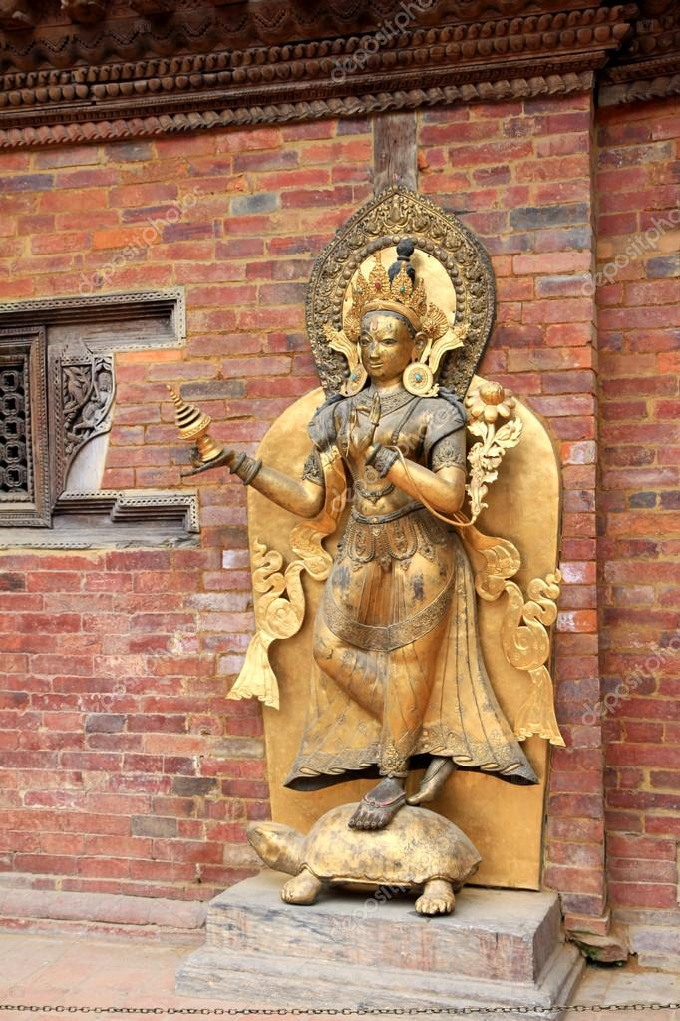
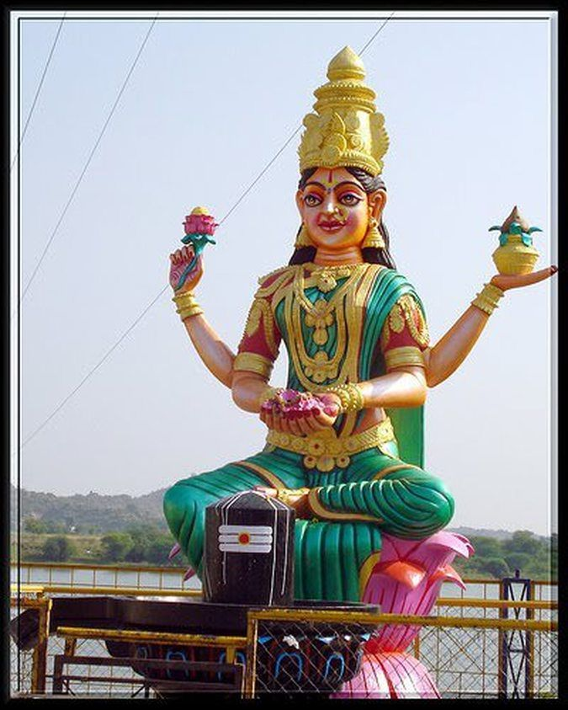

Slide 5
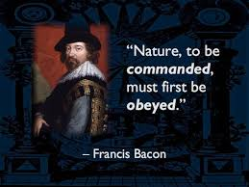
Man and Nature relationships
Shifting historical conceptions:
Enlightenment: Nature as ‘DEAD MATTER’, abiding by mechanical laws.
Nature robbed of ‘mysterious’ qualities. “Disenchantment” from nature.
Baconian doctrine: Discover and MASTER the ‘unknown’ laws of nature. Study/Observe Nature -> CONQUEST of Nature.
“From SACRED GROVE to MERE TIMBER” - Hegel

Slide 6
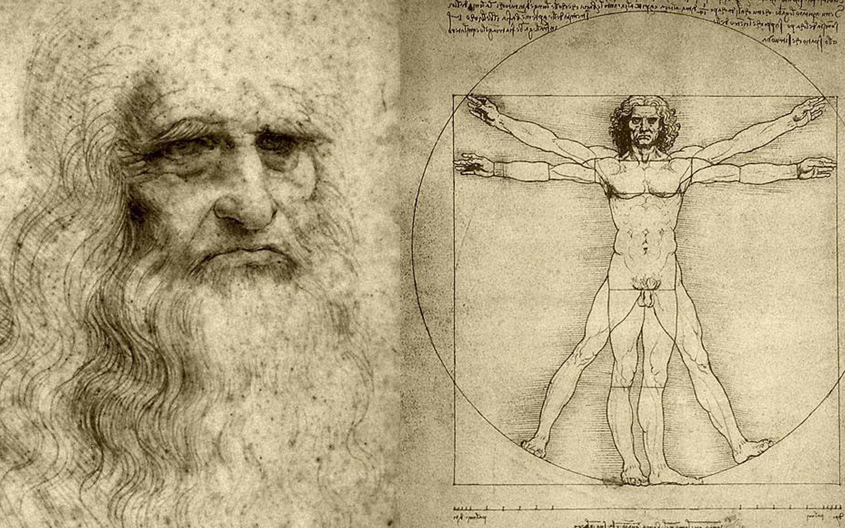

Slide 7
Man and Nature relationships
Shifting historical conceptions:
Modern Industrialism: Nature as RAW MATERIAL waiting to be utilized/exploited.
“The gifts of Nature to man are firstly materials such as iron, stone, wood, etc. and secondly, forces such as the power of the wind, and the heat of the sun” – Alfred Marshal
Man’s job is to efficiently “control” forces/gifts of nature to generate wealth.
DIFFERENCE from Bacon/Descartes? Not only UNDERSTAND but EXPLOIT nature to create “value”.

Slide 8
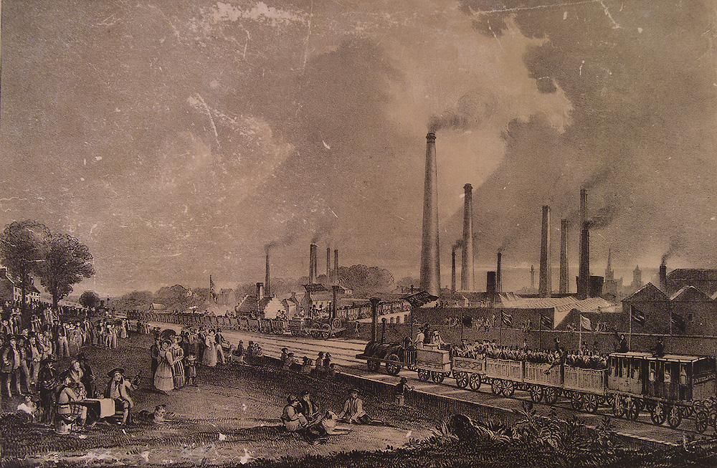

Slide 9
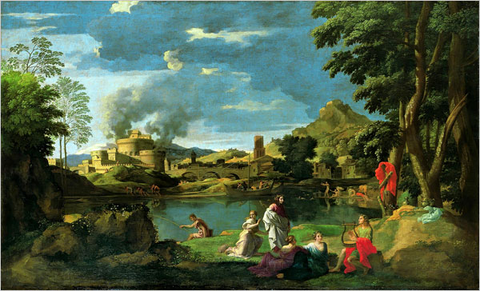
Man and Nature relationships
Shifting historical conceptions:
Romanticism: Response to Enlightenment/Industrial Revolution.
Nature as ALIENATED being – Loss, FRACTURED UNITY of man and nature.
Celebrating the PRIMITIVE/noble savage.
Celebrating RURAL life, simplicity, peasantry. Angst against the ‘chaos’ of the city.

Slide 10
Man and Nature relationships
Geese appear high over us,
pass,
and the sky closes. Abandon,
as in love or sleep,
Holds them to their way, clear in the ancient faith: what we need is here.
And we pray, not
for new earth or heaven, but to be quiet in heart, and in eye,
clear.
What we need is here.
- Walden Berry
The
Romanticism
Intellectual, literary, musical and artistic movement (18th century)
Influenced :
  Liberalism
  Radicalism
  Conservatism
  Nationalism

Slide 11
Man and Nature relationships
I was born in a drought year. That summer
my mother waited in the house,
Enclosed in the sun and the dry ceaseless wind,
for the men to come back in the evenings,
bringing water from a distant spring.
veins of leaves ran dry, roots shrank.
And all my life I have dreaded the return
of that year, sure that it still is somewhere, like a dead enemy’s soul.
Fear of dust in my mouth is always with me,
and I am the faithful husband of the rain,
I love the water of wells and springs
and the taste of roofs in the water of cisterns.
I am a dry man whose thirst is praise of clouds,
and whose mind is something of a cup.
My sweetness is to wake in the night after days of dry heat, hearing the rain.
- Walden Berry

Slide 12
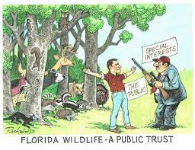
Man and Nature relationships
Shifting historical conceptions:
Romanticism in modern, Western environmentalism: Wilderness campaigns, Preservationists, Big-game conservationists, Vegetarians/Vegans.
Nature as INVIOLABLE/unknowable. ANY use of nature by man is EXPLOITATION.
“Natural” condition of the environment is a VIRTUE in itself.
Criminalization of human-animal coexistence.

Slide 13
  “Man lives from nature, i.e. nature is man’s inorganic body, and he must maintain a continuing dialogue with it if he is not to die. To say that man’s physical and mental life is linked to nature simply means that nature is linked to itself, for man is part of nature”
  – Marx in EPM, 1844.
  “Let us not, however, flatter ourselves overmuch on account of our human conquest of nature. For each such conquest takes its revenge on us…At every step, we are reminded that we by no means rule over nature like a conqueror over a foreign people, like someone outside nature – but that we, with flesh, blood, brain, belong to nature, and exist in its midst, and that all our mastery of it consists in the fact that we have the advantage of all other beings of being able to know and correctly apply its laws”.
  - Engels

Slide 14
Man and Nature relationships
MARXIST theory:
Deep inter-relationship between humanity and nature.
Workers’ FOURFOLD alienation:
  Alienation from nature
  Alienation of labour from products AND “production”
  Alienation from other people/workers
  Alienation from self
  Human societies would have to control interaction with nature. BUT this ‘rational’ control of relations between humans and nature was not the mechanistic domination of nature .
  Labour should work according to the “LAWS of NATURE”.
  Need to protect the basis of “production” of life, i.e. nature. Production is NOT merely economic production.

Slide 15
Man and Nature relationships
WHAT do we learn from shifting historical conceptions of nature?
Each conception of nature tells us SOMETHING about human societies.
Conceptions of nature as SUPERSTRUCTURES of society?
Nature DOES operate according to a set of ‘laws’. BUT, ‘nature’/’environment’ has a significance beyond its mere existence.

